Slide 1
Bank Customer Churn Analysis, Segmentation and Retention Strategy using Data Mining Techniques
AS2022907
E.M.S.J.Ekanayake
ICT 333 1.5 – Data Mining & Data Warehousing

Slide 2

Introduction
Customer churn is a major challenge in the banking sector.
Losing existing customers reduces revenue and long-term profitability.
Retaining existing customers is more cost-effective than acquiring new ones.
Data mining techniques can help identify churn patterns and risky customers.
This project focuses on churn prediction, customer segmentation, and retention strategy.

Slide 3

Problem Statement & Objectives
Problem Statement
It is difficult to identify at-risk customers manually.
Customer behavior depends on many factors such as inactivity, transactions, and credit usage.
Objectives
Analyze customer churn behavior
Apply four analytics discussed in the lecture
Build and evaluate ML models
Segment customers using clustering
Suggest retention strategies
Present insights through a Power BI dashboard

Slide 4

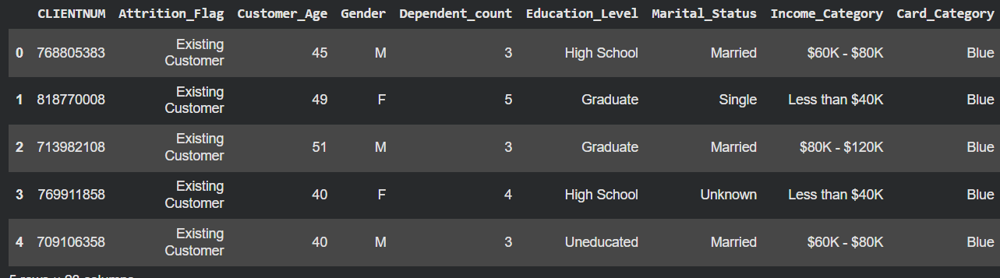
Dataset Overview
Content
Dataset: Credit Card Customers Dataset
Total Records: 10,127
Total Columns: 21
Target Variable: Attrition_Flag
Key attributes:
Customer_Age
Gender
Income_Category
Card_Category
Months_Inactive_12_mon
Total_Trans_Amt
Total_Trans_Ct
Credit_Limit

Slide 5

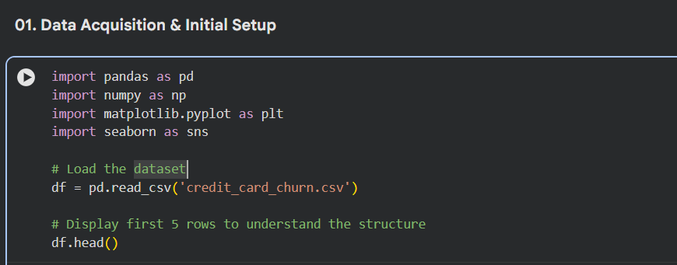
Data Preprocessing
Content
Removed unnecessary columns such as CLIENTNUM
Removed Naive Bayes output columns
Checked missing values and duplicates
Encoded categorical variables
Prepared data for machine learning analysis
Performed train-test split for model evaluation

Slide 6

Four Analytics Applied
Content
Descriptive Analytics – understand customer distribution and churn patterns
Classification Analysis – predict customer attrition
Clustering Analysis – group customers into segments
Association and Outlier Analysis – identify category-based patterns
and unusual behavior

Slide 7

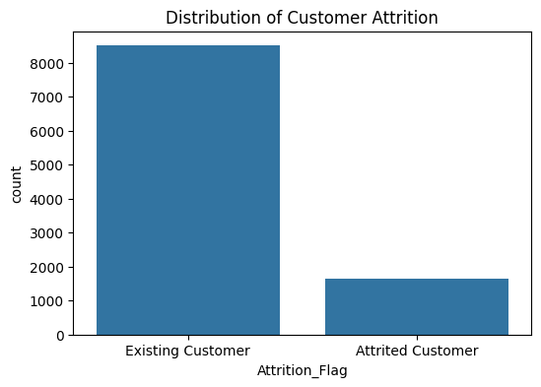
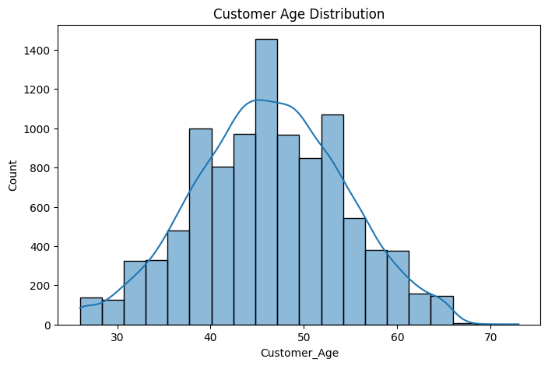
Descriptive Analytics / EDA
Content
Attrited customers are fewer than existing customers
Dataset is imbalanced
Most customers fall within the middle-age range
Initial visualizations help understand customer behavior patterns

Slide 8
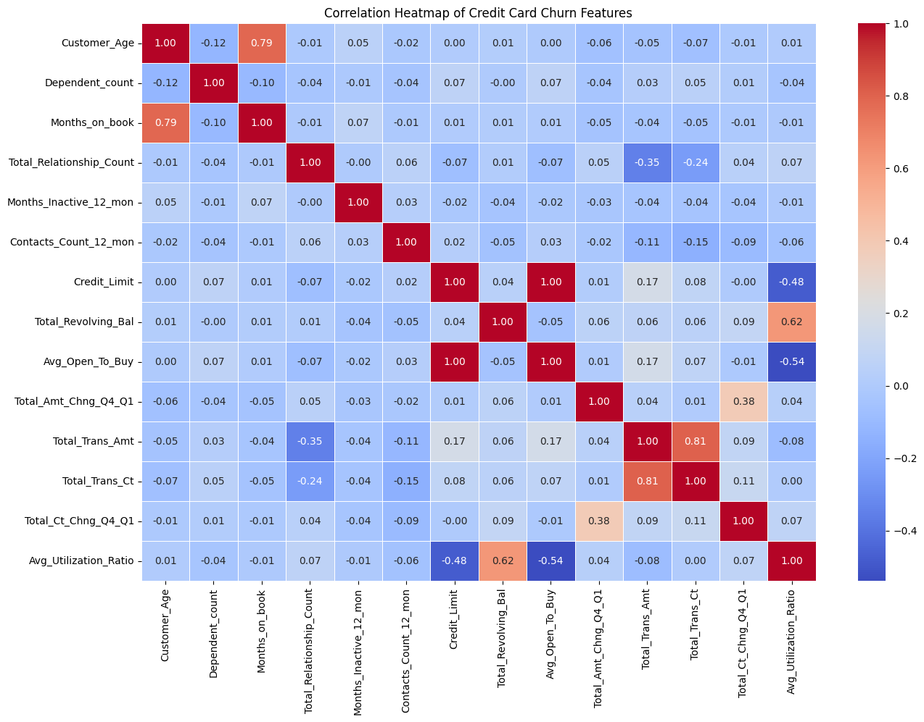
Correlation Analysis
Content
Correlation heatmap was used to examine numerical relationships
Total_Trans_Amt and Total_trans_Ct show a strong positive relationship
Credit-related variables also show meaningful patterns
Heatmap helps identify churn-related features

Slide 9

Classification Models
Content
Three ML models were developed:
1. Logistic Regression
2. Decision Tree
3. Random Forest
Target veriable: Attrition _Flag
Evaluation metrics used:
1. Accuracy
2. Precision
3. Recall
4. F1-score

Slide 10
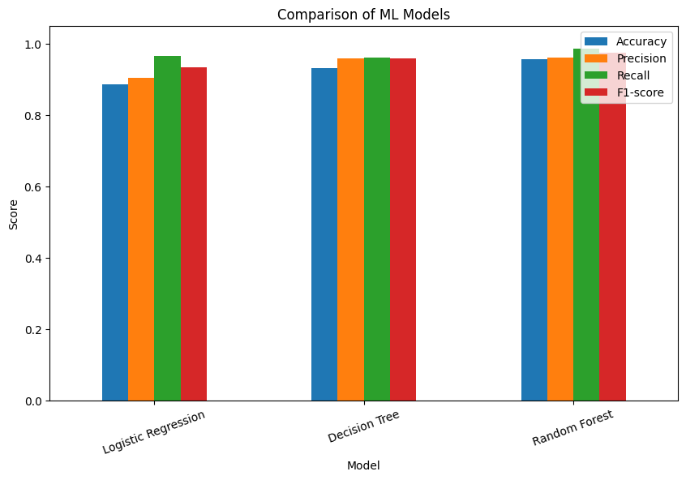
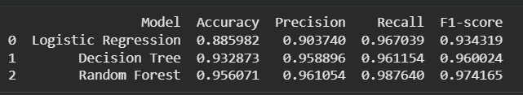
Model Comparison
Content
Random Forest showed the best overall performance
Decision Tree also performed strongly
Logistic Regression produced acceptable but lower scores
Random Forest was selected as the final model
Random Forest achieved the best balance of accuracy, precision, recall, and F1-score.

Slide 11
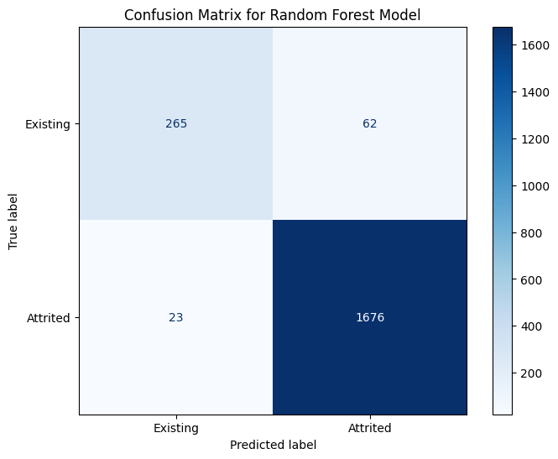
Random Forest Evaluation
Content
Random Forest achieved strong predictive performance:
The model classified churned and existing customers effectively
Confusion matrix confirmes reliable classification resuIlts
Suitable as the final churn prediction model

Slide 12
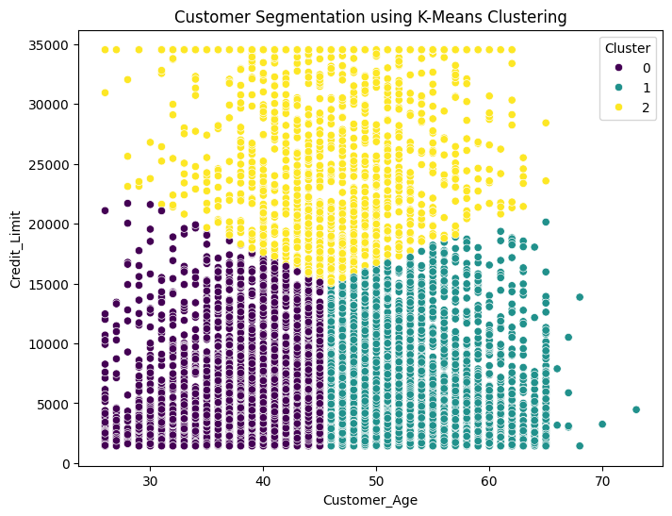
Customer Segmentation using K-Means
Content
K-Means clustering was applied for customer segmentation
Three customer groups were identified
Example segments
1. Standard Users
2. High-Value Users
3. At-Risk / Younger Users
Segmentation supports targeted retention strategy design

Slide 13
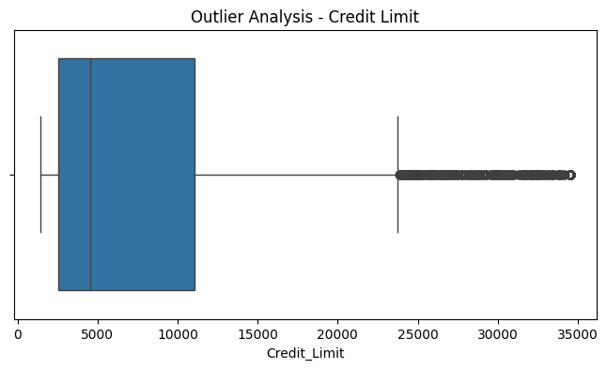
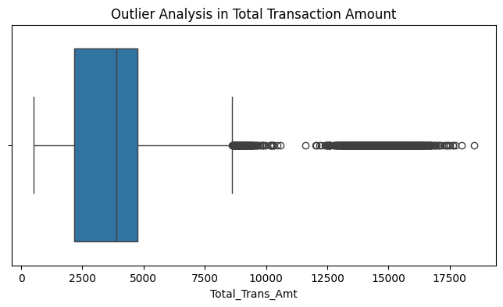
Association and Outlier Analysis
Card category and churn relationship were analyzed
Different customer groups show different churn tendencies
Outlier analysis was applied to Total_ Trans_Amt
Unusual values may indicate abnormal or changing customer behavior
Content

Slide 14
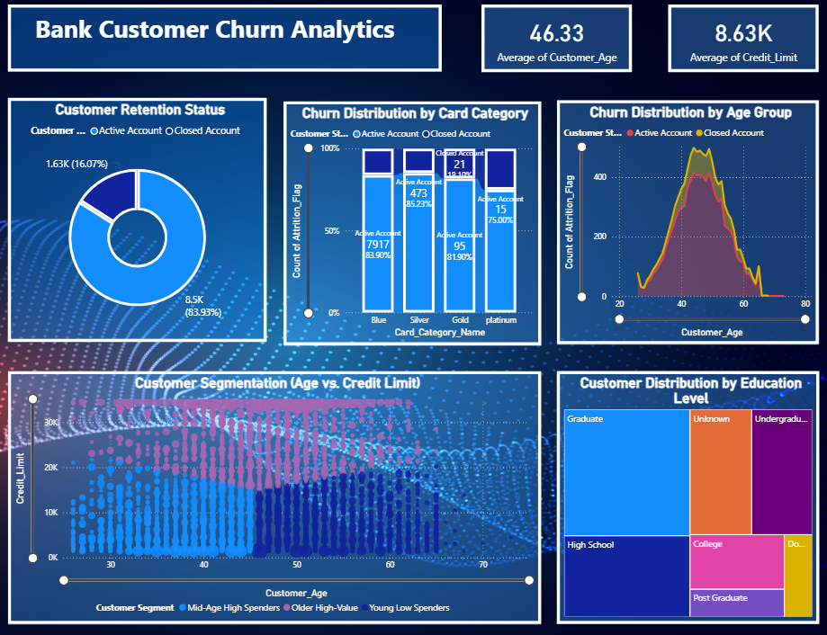
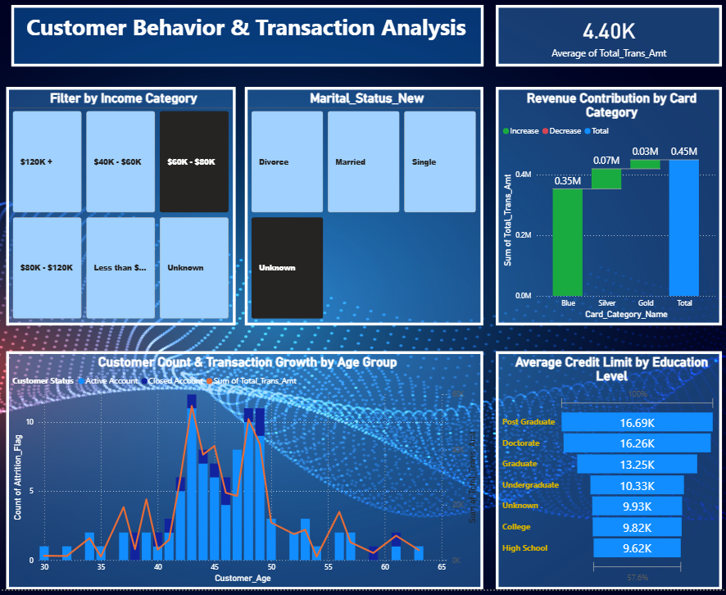
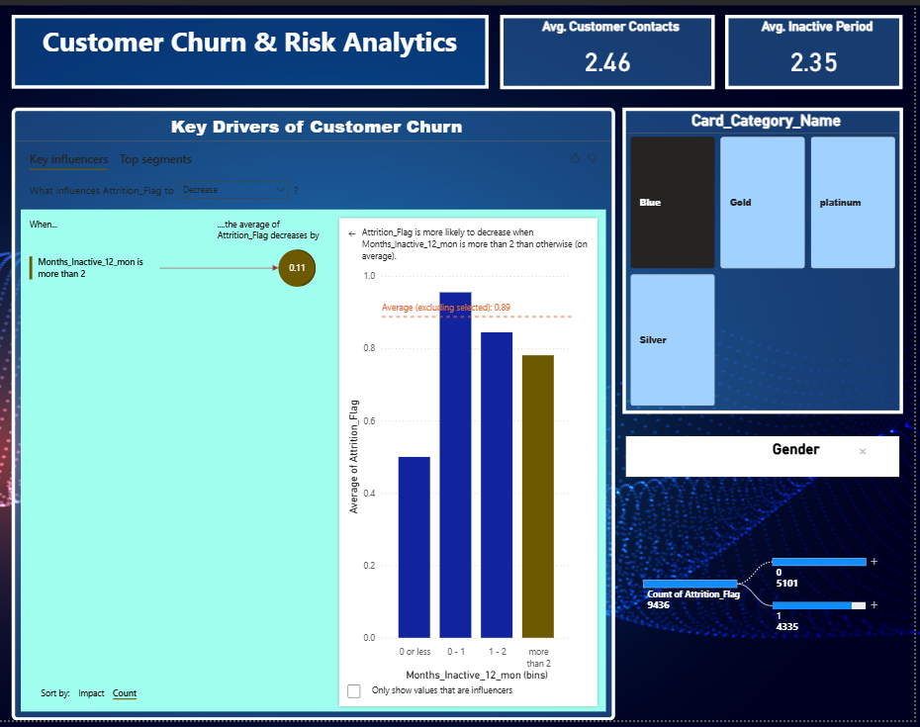
Dashboard Overview
Content
A Power BI dashboard was developed for interactive analysis
Dashboard pages include:
1. Executive Summary
2. Customer Behavior & Transaction Analysis
3. Churn Risk Analytics
Dashboard supports data-driven managerial decisions

Slide 15

Recommendations
Content
Use Random Forest as an early warning system
Focus on low-activity customers with proactive retention actions
Offer targeted incentives to high-value customer segments
Improve digital engagement for inactive users
Promote multi-product enrollment to increase loyalty
Use dashboard insights for continuous monitoring

Slide 16

Conclusion
Content
The project successfully analyzed customer churn in the banking sector
Four analytics techniques were applied
Multiple ML models were built and compared
Random Forest was identified as the best model
K-Means clustering helped identify meaningful customer segments
The dashboard provided actionable business insights for retention strategy

Slide 17

AS2022907
E.M.S.J.Ekanayake
ICT 333 1.5 – Data Mining & Data Warehousing

